Slide 1
5 Ways to Make Your DBA Happy
Whitney May

Slide 2
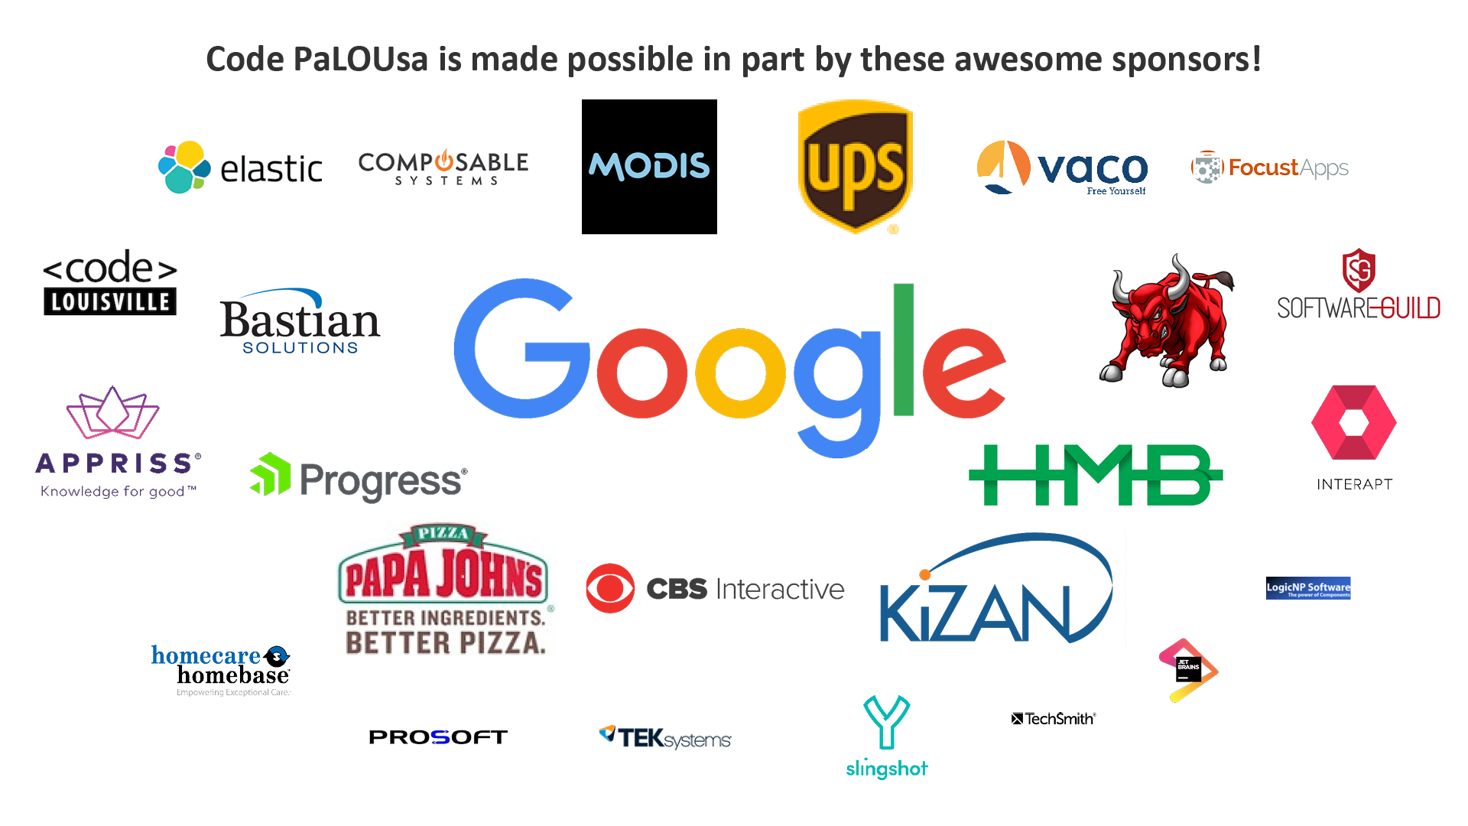

Slide 3



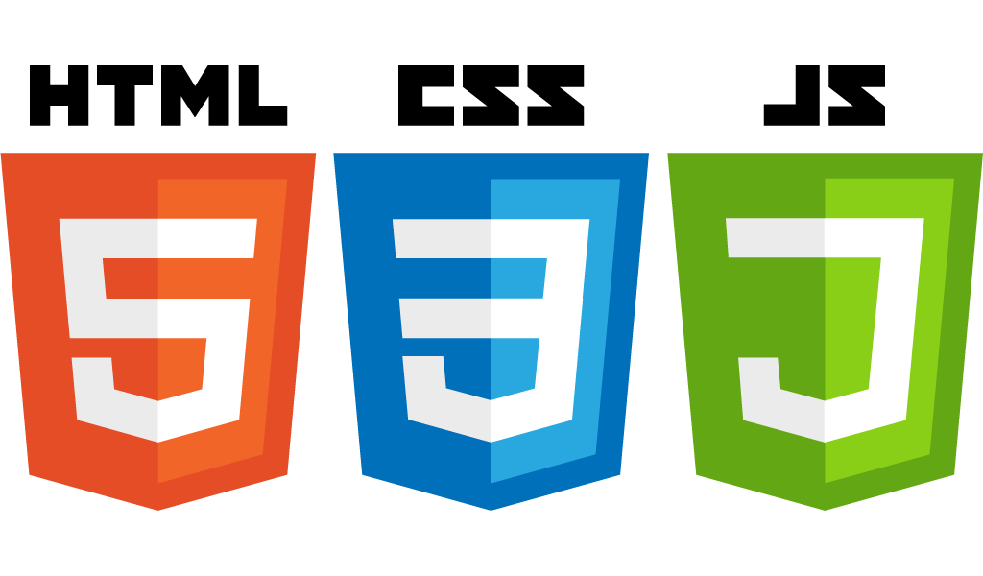

About Me

Slide 4
Avoid Production Environments!
Notes:
Avoid Prod environments at all possible, have a change or flow control for db updates. DBMaintain - if possible

Slide 5
If you have to use production...
Make sure to have a rollback for your scripts everytime you need to run a script in production. If a DBA is running a script for you, make sure to send them a rollback as well.
If you are running a script that removes data, make sure to keep a file with the old values.

Slide 6
Other Environments
As non-production environments, it is still important to restore your scripts but not as vital as a production environment.

Slide 7
Use Transactions
To avoid having data loss, use transaction with your procedures and queries. If you are not receiving the expected result you can always roll back.
BEGIN TRAN UpdateGroup; UPDATE Stores
Set Group= ‘MW123’
WHERE STATE = ‘OH’ ROLLBACK UpdateGroup
COMMIT TRAN UpdateGroup;

Slide 8

Redgate SQL Source Control
Plugs into SQL Server Management Studio
Works with TFS, Subversion, and Git
Offers a 28 day free trial
You can download this product at https://www.red-gate.com/products/sql-development/sql-source-control/

Slide 9
DBMaintain
Version control for your database
Currently on github
Easily track scripts that have been moved to the database
You can download it at https://github.com/DbMaintain/dbmaintain

Slide 10
Why having rollbacks is Important
-Very hard for a DBA to restore a database
- Very difficult to track a transaction, especially if there are thousands a day
- Not having a rollback could cause lost data

Slide 11
Know Your ORM

Slide 12
Using Code First with an ORM
Very popular among developers
Allows the developer to have total control of your code (no auto generation)
Can easily modify models
Makes versioning easier
However…
All the database will come from the code, so if you don’t know how your ORM will affect the database, you could cause issues such as unwanted columns and data.

Slide 13
Object-Relational Impedance Mismatch
Relational databases such as SQL and Oracle do not represent data the same way as object-oriented programming languages such as Java and C#. This is the main reason it is important to know how your ORM will react with the database.

Slide 14
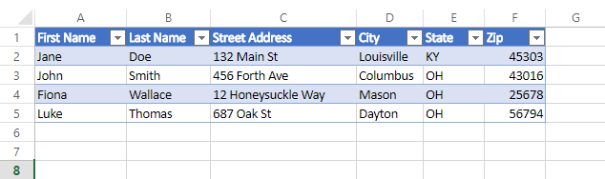
How Relational Databases Represent Data

Slide 15
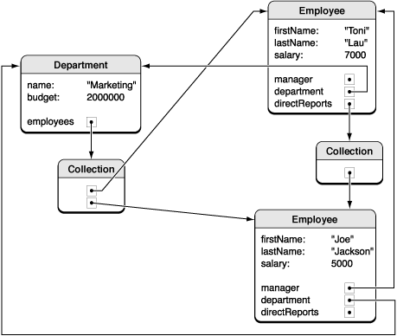
How OOP Represents Data
oaEncyclopedia/ObjectModeling/ObjectModeling.html
https://developer.apple.com/library/content/documentation/General/Conceptual/CocoaEncyclopedia/ObjectModeling/ObjectModeling.html

Slide 16
Granularity
Often times, you will have more classes in your code than tables in the database.

Slide 17
Subtypes (inheritance)
OOP Languages recognize inheritance while relational databases do not.

Slide 18
Associations
Relational databases use foreign keys for associations while ORM use relationships (like traveling directly from one entity to another). You need to manually create foreign keys in an ORM.

Slide 19
Identity
Relational databases recognize identity as the primary key. ORMs acknowledge both object identity and object equality.

Slide 20
Data navigation
Relational databases use joins for data navigation while ORMs go through an object network. In this case, the relational database is significantly more efficient at data navigation.

Slide 21
How to Mitigate these issues
Check your migrations before moving to be the database
Make sure to manually add any keys in your model
Utilize your DbSet class

Slide 22
Improve Your Models
Utilize Data Annotations such as [Key]
Make sure to include associations that SQL can interpret as foreign keys
Create indexes when using your model. From Entity Framework 6.1, you can add index to your model directly.

Slide 23
Utilizing DBSet class
A DB set is a class that represents a table from your database.Some common uses of a DBSet class include the following:
-Adding to the database
-Deleting from the database
-Editing a record from the database
-Finding a record from the database

Slide 24
Use Database Appropriately

Slide 25
Retrieve only what you need
Avoid selecting an entire entity in your code. Only retrieve what you need at the time. In other words, avoid lazy loading.
Also, for queries, use filters such as WHERE wherever possible.
Notes:
Lazy loading

Slide 26
Use Mocking for Unit Tests
To avoid database dependency for tests, use mocking. There are several great tools out there including Moq (.NET) and Mockito (Java).

Slide 27
Use Caching
To avoid performance issues with the database, use caching whenever appropriate. Very few queries need to be run every 3 seconds.
Notes:
Cache when you find it approp. DB Query cache for you

Slide 28
Caching and ORMS
In some ORMs, queries are automatically cached. For example, starting with the .NET Framework 4.5, LINQ queries are cached automatically. However, Enumerable.Contains operator is not. For those, feel free to use Compiled Queries class.

Slide 29
Database Query Caching
Most ORMs include first-level caching which is specific to a session. In the situation of services and web applications, it may be helpful second-level caching. Second-level caching can be used across multiple sessions, so the database won’t be called as frequently.

Slide 30
How to Implement Second-Level Caching
To implement second-level caching, you may need to create your own classes and providers. There are a few tools that may be helpful.
For Entity Framework , there is a Nuget Package called EntityFramework.Cache for Entity Framework 6.0 and above. EF+ Query Cache supports down to Entity Framework 4.0.
For Hibernate, there are a few vendors: EH Cache,OS Cache , Swarm Cache, JBoss Cache.

Slide 31
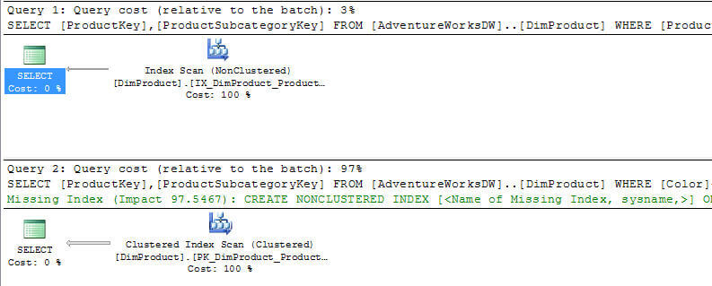
Query Execution Plans
https://www.mssqltips.com/sqlservertutorial/285/query-execution-plans/

Slide 32
Query Execution Plans cont
To create a query execution plan, use the following:
Actual Execution Plan - (CTRL + M) - is created after execution of the query and contains the steps that were performed
Estimated Execution Plan - (CTRL + L) - is created without executing the query and contains an approximate execution plan

Slide 33
Find Balance
Notes:
Code first

Slide 34
Use normalization in your tables but not too much
Normalization is necessary for proper database design, but too much normalization can impact database performance and cause data issues.

Slide 35
Foreign Keys
Pros
Improve data integrity
Decreases data redundancy
Cons
Can cause a decrease in performance for CRUD operations
Can also cause issues with historical data

Slide 36
Reference Tables
Great for linking tables but too many reference tables can make your queries very slow. They should generally be two columns that are composite keys.

Slide 37
Indexes
Can improve database performance
Uses less system resources
They should not be used on
Tables with few columns
Static tables
Doing so will be ineffective and actually decrease database performance

Slide 38
Cursors
Look at data row by row, so they can impact database performance
Use sparingly
Use JOINS instead

Slide 39
Be considerate

Slide 40
Understand that your DBA is very busy
DBAs often have several other users asking for similar requests. Unless something is urgent (urgent to the business, not you), then your request may take some time.

Slide 41
Send as much information as possible
When you are having an issue, send as much information as possible. Make sure to know your database information. Also, include columns and tables if possible.

Slide 42
Be accessible
If a DBA needs to ask you a question, please don’t take seven days to respond. Try to answer them as soon as you can.

Slide 43
Make sure to Plan
When scheduling a release, make sure to document all of the scripts that need to be run. If the DBAs are not involved in a release, make sure that they are aware of any database changes.

Slide 44
Be open to their advice
If your DBA has an idea for a better design, at least be open to it. A DBA wants to help you. They are your friend not your enemy.

Slide 45
To learn more check out these sites
http://hibernate.org/orm/
https://msdn.microsoft.com/
https://docs.oracle.com/

Slide 46
Contact Me
LinkedIn - https://www.linkedin.com/in/whitney-may-24a3a52a/ Github - https://github.com/wmay1991

Slide 47
Any questions?

